Slide 1
The Future of Minnesota Drinking Water: A Framework for Managing Risk
Presentation to: LCC Sub-Committee on Minnesota Water Policy
Peter Calow, Ann Lewandowski, Lucia Levers, Eileen Kirby

Slide 2

Our charge
Identify opportunities for MDH to better manage risks to drinking water
Building on recognized existing strengths
We concentrate on public water systems and pay a little attention to private wells
Reviewed literature and some other jurisdictions
Recommendations informed by expert panel and stakeholders

Slide 3
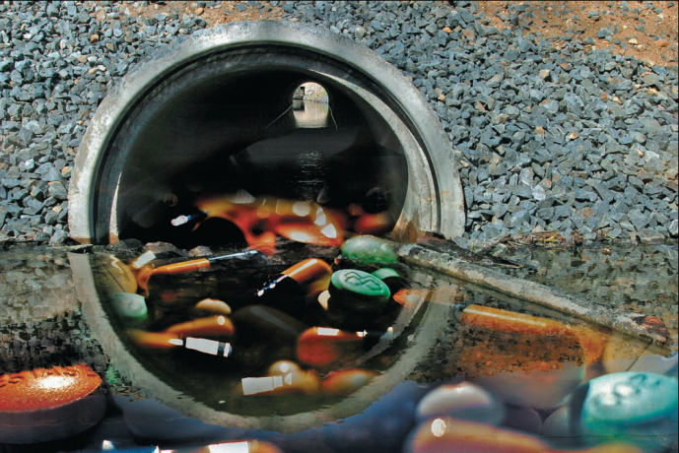
Key challenges
Systems face an increasing array of potential contaminants from agricultural, industrial and personal use
Systems are complex and in parts aging
Extreme weather events
Declining populations in rural communities
Pandemic policy paralysis for all except COVID

Slide 4
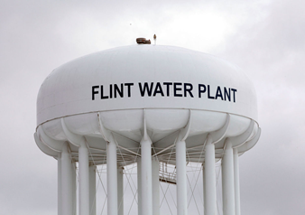
Core recommendation
Focus on developing a good governance system that can respond in an integrated and flexible fashion to emerging challenges and do so in a way that commands public confidence
Develop a drinking water plan?
Notwithstanding COVID many previous public health problems have centered on drinking water. Need to be tuned to these vulnerabilities with an integrated approach based on our governance assessment framework.

Slide 5

Rationale
Governance = institutional arrangements for policy delivery
Without it even the best intentions for investments in infrastructure or for optimizing management from source to tap are likely to founder
OECD emphasizes that it has to be effective, efficient and command public trust

Slide 6
Surveyed key people in MDH, and our experts and stakeholders on how well they thought this state did re these governance criteria
Need more (obvious) integration
Need more (credible) involvement of the public affected
Need more effective (creative) ways of covering costs in sparsely populated places

Slide 7
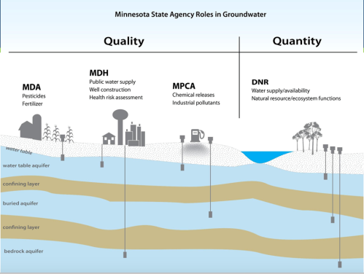
On the integrated approach: address perception of separation rather than integration
Large number of agencies with split statutory responsibilities
Legacy Amendment has catalyzed interaction
Make it more explicit
Underpin with statutes that clarify responsibilities – and bases them on providing safe and sufficient drinking water for all in a way that respects environment
How far to go should depend on costs, benefits and equity
Minimally need a coordinating body

Slide 8
On public involvement: empower not just inform
Engage critical communities and leaders
Give them a voice in all aspects from strategic to responses to acute challenges
As technology increasingly allows get them involved in monitoring and managing quality from their own taps

Slide 9
On challenges of covering costs: consider consolidation of rural suppliers
as one possible response to financial challenges
But base it on careful appraisal
Chart the landscape of affordability by connecting data on community demographics and population trends with income, expenses and debt status at family and community level.
Compare with drinking water technology needs
Also consider staffing challenges

Slide 10


Also need to be cost effective in addressing many possible contaminants
Message for MDH: continue to prioritize contaminants for attention and action on basis of sound science. But use CRA and CBA.
Message for suppliers: More flexibility based on what is present. This follows water safety plan approach of WHO. But is challenged by inflexibility of SDWA and need for expertise.

Slide 11
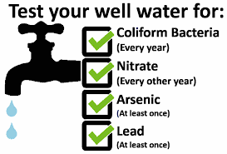
Not to forget private wells
MDH has statutory authority over siting new wells
But the rest is voluntary supported by educational programs
Revisit a statutory requirement for testing at sale of property

Slide 12
Conclusions
Good governance provides the foundations
Make it obviously integrated
Engage the public as partners
Address challenges for small communities
Compare risks on the basis of sound science and cost-benefit analysis
Explore the advantages and drawbacks of water safety plans tailored to local hazards
Revisit private wells

Slide 13
End Slide

